Slide 1
Liceo mixto los andes- básica 1.

Slide 2
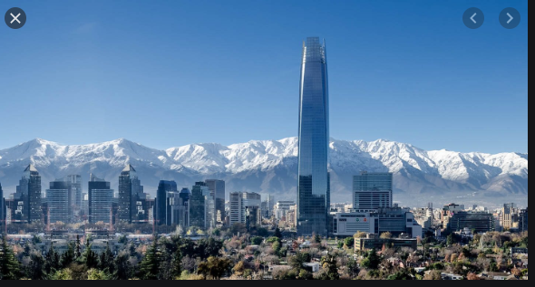
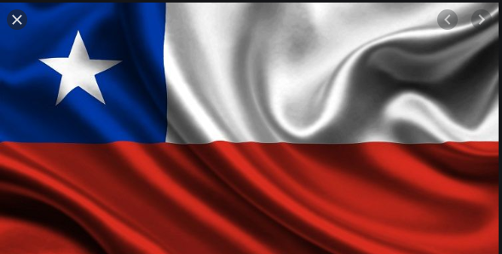
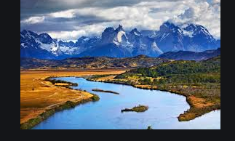
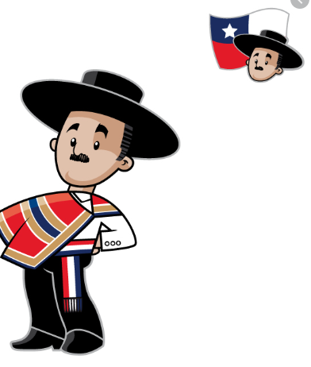
Welcome

Slide 3
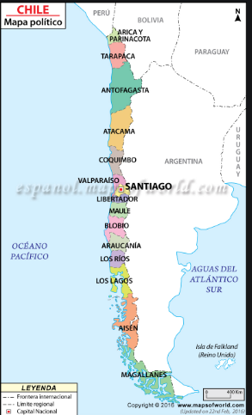

Slide 4
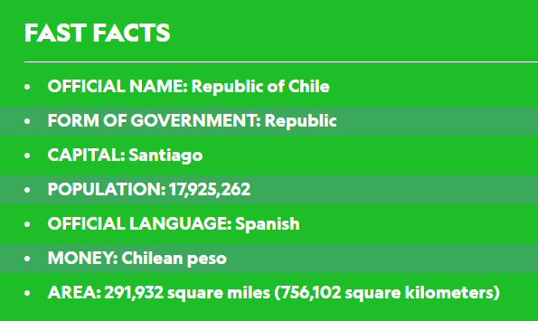
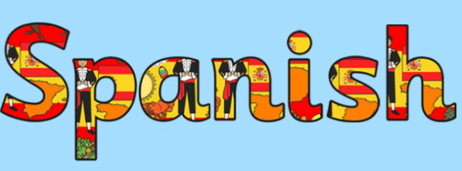
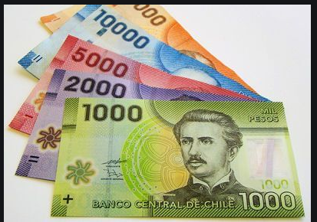

Slide 5
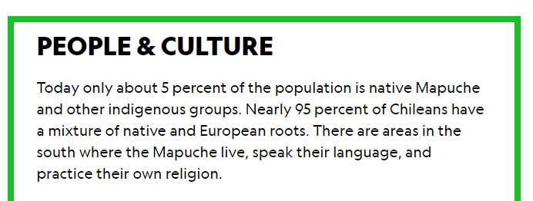
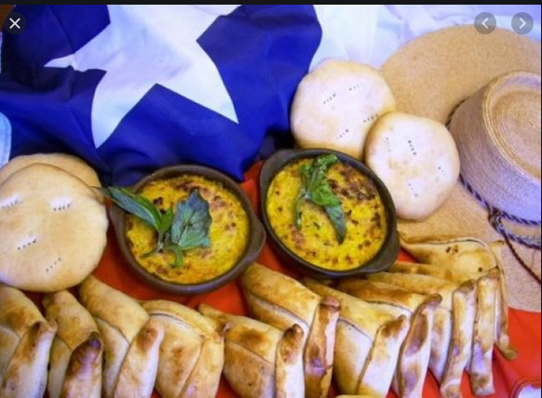
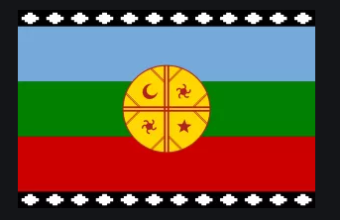
https://kids.nationalgeographic.com/explore/countries/chile/#/1252858947869
WATCH VIDEO ABOUT SOUTH AMERICA

Slide 6
Select the Correct Option.

Slide 7
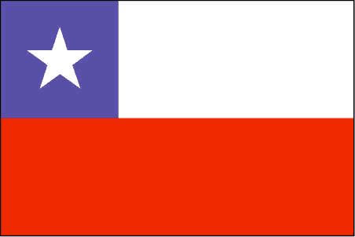
What color is the Chile´s Flag?
black, blue, and White.
Blue, White and Green.
Blue, White and red.

Slide 8
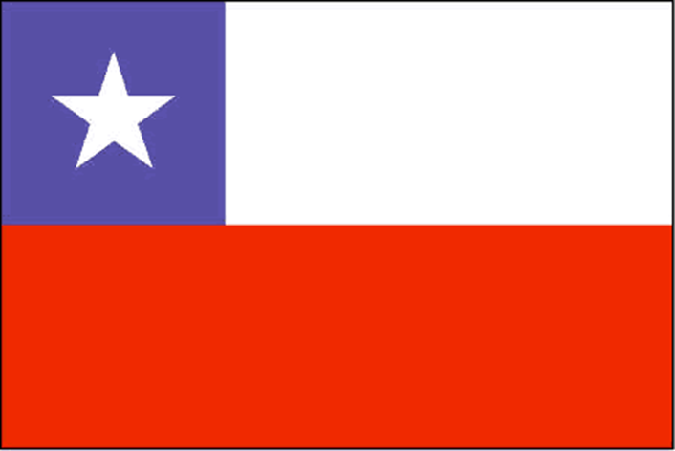
GREAT ! BLUE, WHITE AND READ

Slide 9
Chile Map is like a:
A. like a cirle Map.
B. like a narrow Map .
C. like a trinagle Map.

Slide 10
What is the Chile´s oficial name?
A. Chile Republic.
B. Republic of Chile.
C. Chile

Slide 11
What is the oficial Chile´s Language?
A. Spanish
B. Spanish and Mapuche Tonge.
C. English Language.

Slide 12
What is the ( % ) per cent of population native Mapuche?
A. 10 % per cent.
B. 5% per cent.
C 20 % per cent.

Slide 13
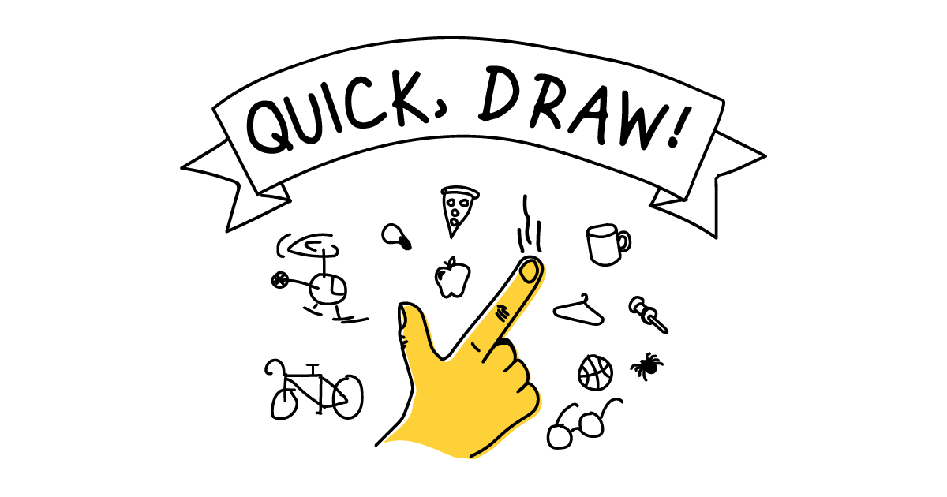
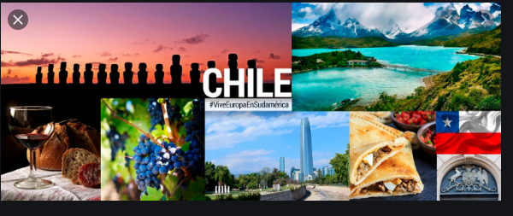
Activity # 2.
DRAW A POSTER THAT REPRESENT A RESUME OF THIS PRESENTATION.

